Slide 1
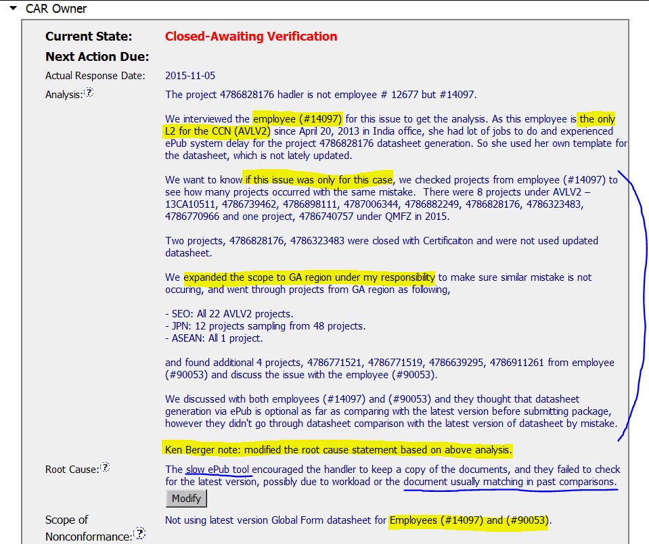
CAR 153915111 - Finding
Key stakeholder identified, but I’d recommend to include reviewer & quality manager for more effective investigation
Based on horizontal deployment concept, risk impact analysis was conducted as appropriate
Rewording of root cause statement for better description by CAR Champion
Analysis shows clear path to root cause

Slide 2
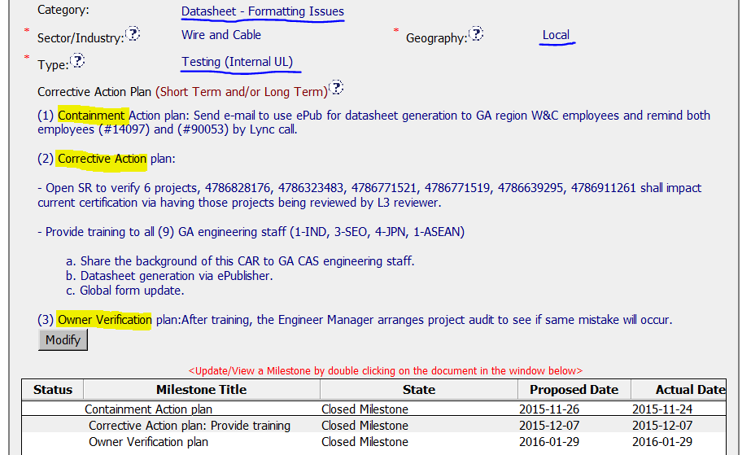
CAR 153915111 - Finding
Appropriate ‘category’, ‘geography, ‘type’ are selected as well.
Corrective Action Plan including containment, short & long-term plan
Milestone aligned with corrective action plan

Slide 3
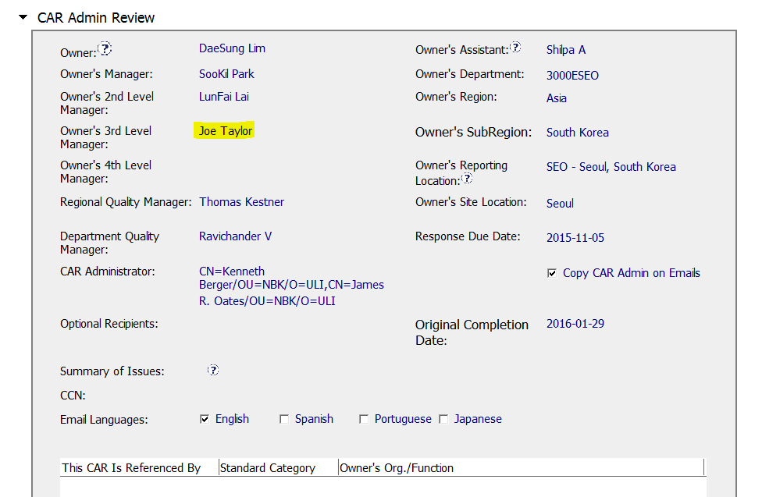
CAR 153915111 - Finding
Removing of presidents of business units from the management path

Slide 4
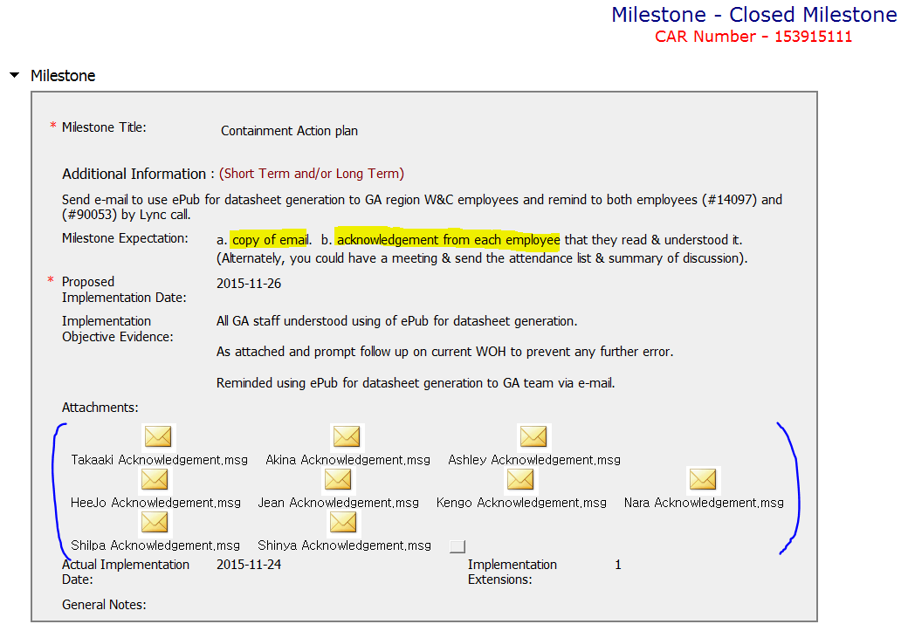
CAR 153915111 - Finding
Very clear and concrete milestone expectation from CAR Champion
Milestone completed per milestone expectation
Confirmation from all trainees on awareness related to announcement included as objective evidence

Slide 5
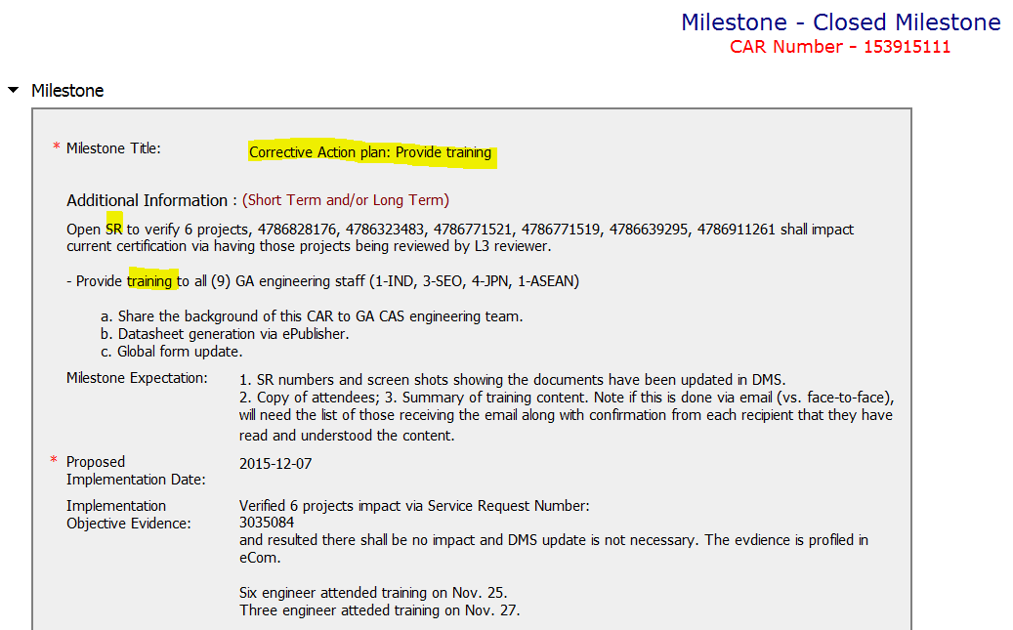
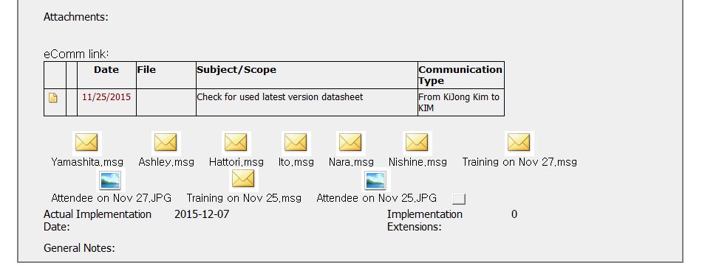
CAR 153915111 - Finding
Milestone completed per milestone expectation
Confirmation from all trainees on awareness after training included as objective evidence

Slide 6
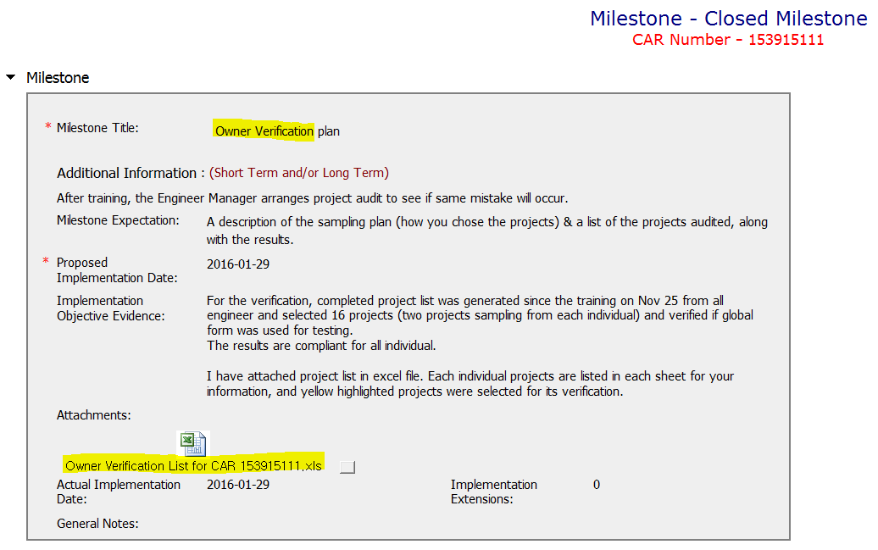
CAR 153915111 - Finding
Milestone completed per milestone expectation
Objective evidence attached as appropriate

Slide 7
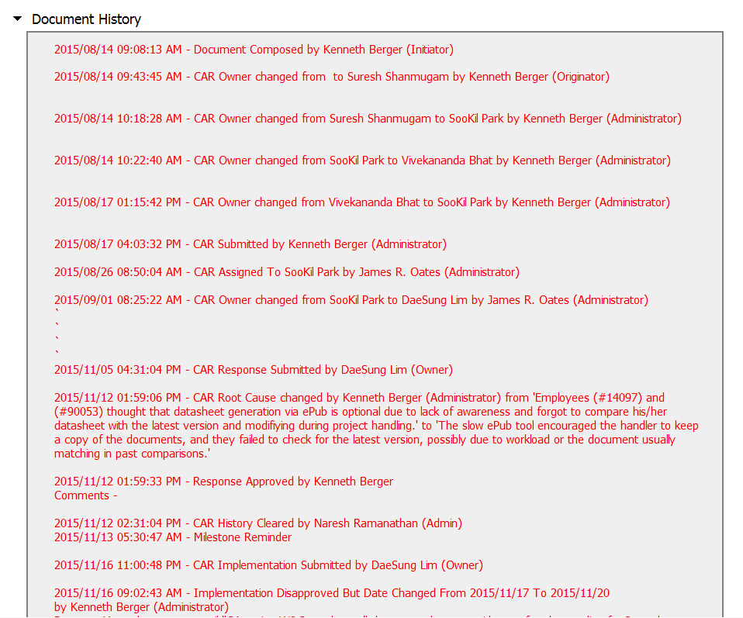
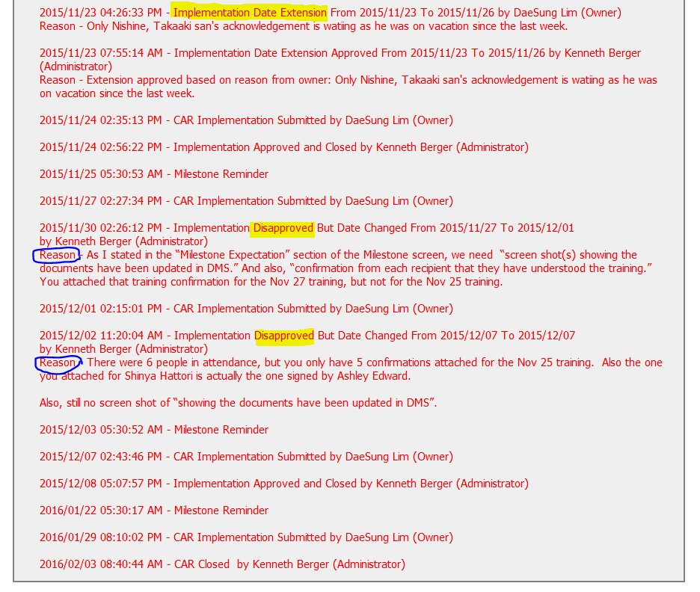
CAR 153915111 - Finding
Just one time extension for implementation
CAR Champion’s facilitation to ensure the perfection of implementation evidence

Slide 8
CAR 153915111 – CBS Check
CBS Requirements | Excellent | Moderate | Need Improve | N/A
(C) Extensions are within requirement (<30 days, 3 or less) |  |  |  | √
(T) Most appropriate ‘category’, ‘type’, ‘geography’ are selected | √
(P) Facilitates the handling of disputed CARs | √
(T) Acts on CARs within required timeframe | √
(C) Analysis shows clear path to root cause and scope; stakeholders identified |  | √
(C) Root cause statement is succinct, reasonable, complete (Shows ‘N/A’ for observations) | √
(C) Corrective actions fix the objective evidence and other problems found; address entire root cause and scope. For observations, they do not go beyond fixing the objective evidence | √
(C) Milestones address containment & owner’s verification; completed per milestone expectations | √
(P) Verification per requirements | √
(L) Referenced communications are attached as needed |  |  |  | √
(C L) Evidence of communication for overdue/escalated CARs and other pertinent concerns |  |  |  | √
(P) Trains other CAR Champions |  |  |  | √

